Slide 1
Student Registration Form using Full Stack Java
By Mohamed Raffi

Slide 2
Abstract
The Student Registration Form project is a web-based platform developed using HTML, CSS, JavaScript, Java, and MySQL to automate the student enrollment process.
It simplifies student data collection, reduces manual errors, and ensures data accuracy through validation and secure database storage.
The application offers a user-friendly interface for students to register online, while administrators can manage records efficiently.
It bridges the gap between manual recordkeeping and digital automation by integrating modern web technologies with database management.

Slide 3
Existing System
In most institutions, the student registration process is still manual or semi-manual.
Students fill paper-based forms, and staff manually enter data into spreadsheets or standalone systems.
This approach is time-consuming, error-prone, and lacks real-time validation.
Data duplication, loss, or misplacement is common, and reporting requires manual effort.
Updating or retrieving student information is difficult, especially when records are large.
Limitations:
Manual data entry errors
Lack of proper authentication and security
Limited data accessibility
Poor scalability and maintainability

Slide 4
Proposed System
The proposed system is a fully automated web-based registration platform.
It enables students to register online from anywhere using a responsive form built with HTML and CSS.
JavaScript handles real-time validation to ensure correct input (e.g., email format, password strength).
Java (Servlets/JSP) manages backend logic, and MySQL stores student records securely.
The system supports CRUD operations (Create, Read, Update, Delete) for managing student data.
Administrators can view, search, and modify student records efficiently.
Features:
User-friendly web interface
Secure authentication and session management
Error-free data validation
Dynamic interaction between frontend and backend
Efficient data storage and retrieval

Slide 5
Advantages
Automated process reduces manual work and human errors.
Real-time validation ensures data accuracy.
Centralized database for easy access and management.
Improved security through controlled access and validation.
Scalability — can handle a large number of students.
Reduces paperwork and administrative overhead.
Accessible from any internet-connected device.

Slide 6
Disadvantages
Requires stable internet connection.
Initial setup and configuration require technical expertise.
Possible maintenance and hosting costs.
Vulnerable to cyberattacks if not updated regularly.
Dependence on hardware and software compatibility.

Slide 7
Hardware Requirements
Component | Specification
Processor | Intel Core i3 / AMD Ryzen 3 or above
RAM | Minimum 4GB (8GB recommended)
Storage | At least 500MB free space
Input Devices | Keyboard, Mouse
Display | 15-inch Monitor or higher
Network | Internet connectivity for web access

Slide 8
Software Requirements
Category | Software
Operating System | Windows / Linux / macOS
Frontend | HTML, CSS, JavaScript
Backend | Java (Servlets / JSP)
Database | MySQL
IDE | Eclipse, IntelliJ IDEA, or VS Code
Browser | Google Chrome / Mozilla Firefox / Edge
Web Server | Apache Tomcat

Slide 9
Modules
Student Registration Module – Captures student details through web forms.
Validation Module – Checks data accuracy and format (email, number, etc.).
Database Management Module – Handles all interactions with the MySQL database.
Login & Authentication Module – Manages user access securely.
Admin Dashboard Module – Enables admins to view, update, or delete student records.
Report Generation Module – Generates summaries or reports of registered students.

Slide 10
Module Description
Student Registration Module: Provides input fields for personal, academic, and contact details. Ensures required fields are completed before submission.
Validation Module: Uses JavaScript for client-side validation and Java for server-side checks to prevent invalid or duplicate entries.
Database Management Module: Handles data storage, retrieval, and updates using SQL queries and JDBC connectivity.
Login & Authentication Module: Implements secure login for both students and admins. Passwords are encrypted before storage.
Admin Dashboard Module: Provides a graphical interface for managing registered students, including searching and sorting data.

Slide 11
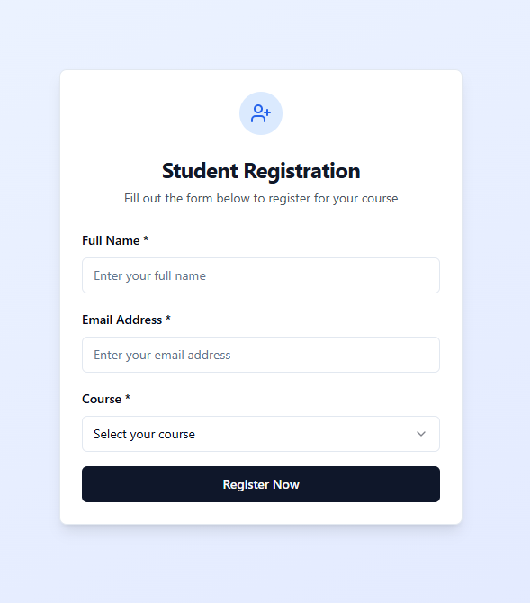
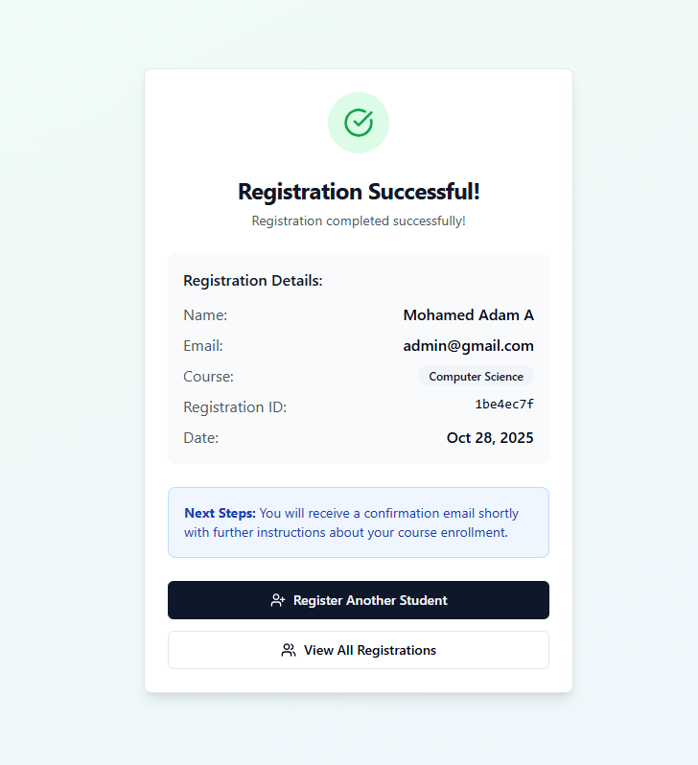
Sample Output

Slide 12
Conclusion
The Student Registration Form Project offers a modern solution for digitalizing student data management.
It integrates web technologies and databases to deliver a secure, user-friendly, and efficient registration process.
By reducing human effort and improving accuracy, it provides long-term benefits to both students and institutions.
The system can be further enhanced by adding features like email confirmation, OTP verification, and cloud-based database hosting.

